Slide 1
Machine Learning sensors fusion of LiDAR and HS for classification map
Francesca Stefano and Giovanni Schianchi

Slide 2
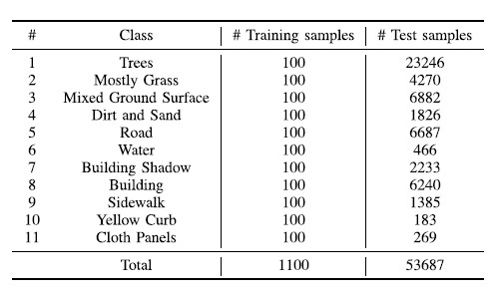
Dataset & Goal
The MUUFL Gulfport dataset is an HS-LiDAR dataset. It was collected over The University of Southern Mississippi.
In the ground truth labels, there are 11 classes
On a practical level, data from LiDAR and HS were merged to obtain classification maps based on the different predefined categories of the dataset.

Slide 3
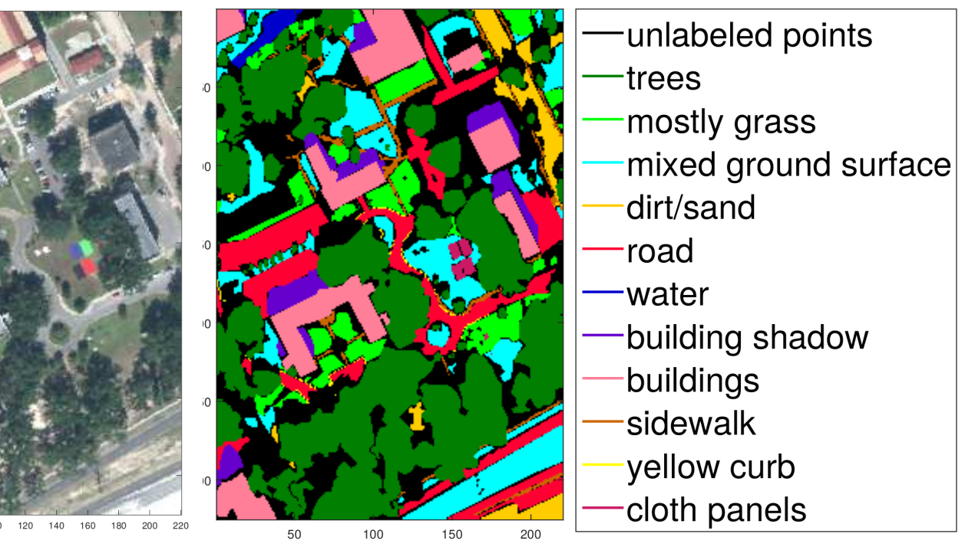

Slide 4

Tools & Algorithm
Python
CUDA
ResNet18
ResNet50
TB CNN

Slide 5
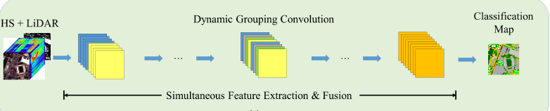
Fusion & Implementation
 | ResNet18 | ResNet50 | TB CNN
epochs | 22 | 22 | 22
learning rate | 0,02 | 0,01 | 0,001
optimizer | SGD | Adam | Adam
batch size | 48 | 64 | 48
sample radius | 5 | 8 | 5
learning schedule | [200, 400] | [300, 350] | None

Slide 6

Code
Main.py
Train.py
Test.py

Slide 7
Results
 | ResNet18 | ResNet50 | TB CNN
Accuracy | 90.545 | 79.455 | 97.818
Losses | 0.253 | 0.860 | 0.073
K_scores | 0.726 | 0.683 | 0.823
Oa_array | 0.786 | 0.75 | 0.863

Slide 8
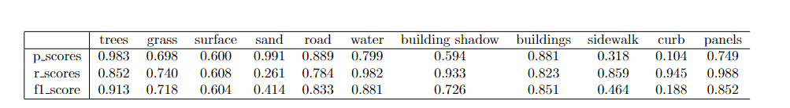
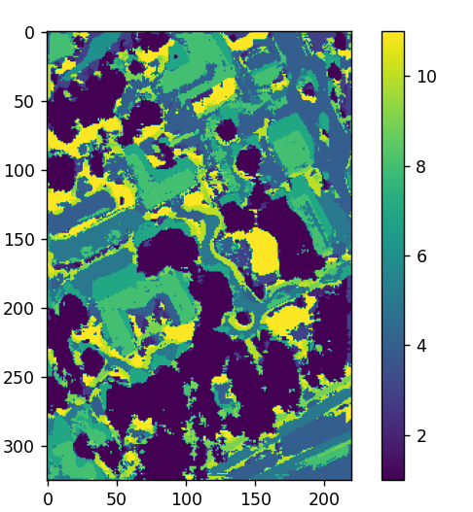
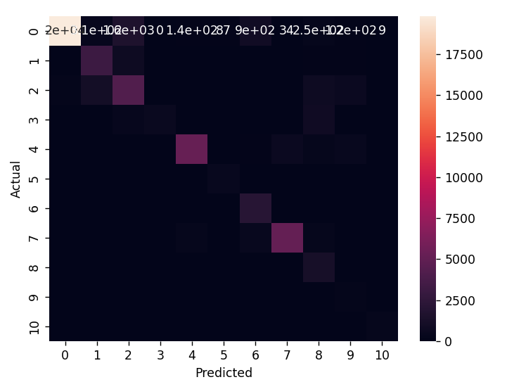
Results ResNet18

Slide 9
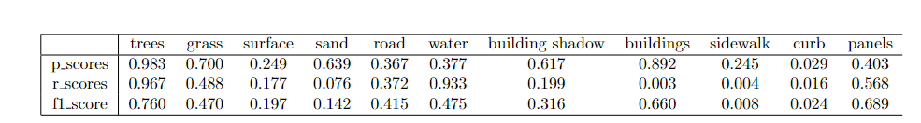
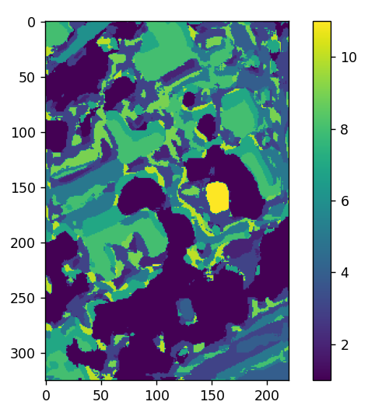
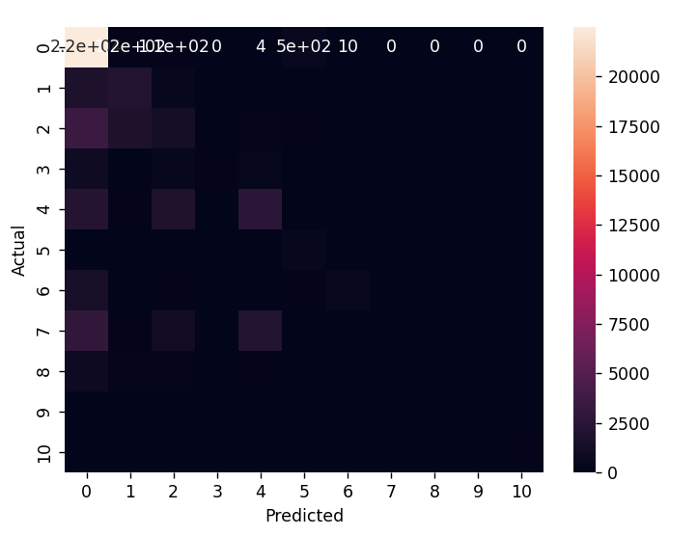
Results ResNet50

Slide 10
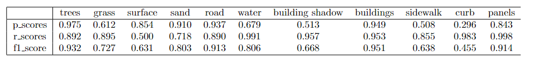
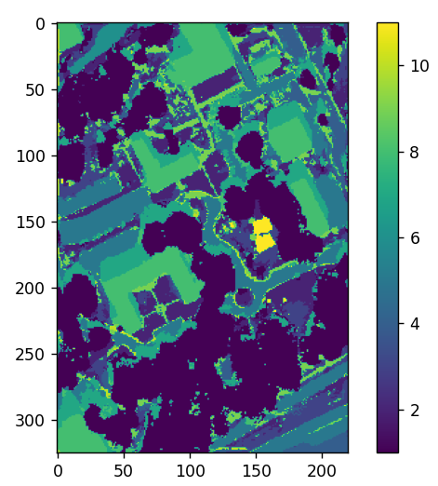
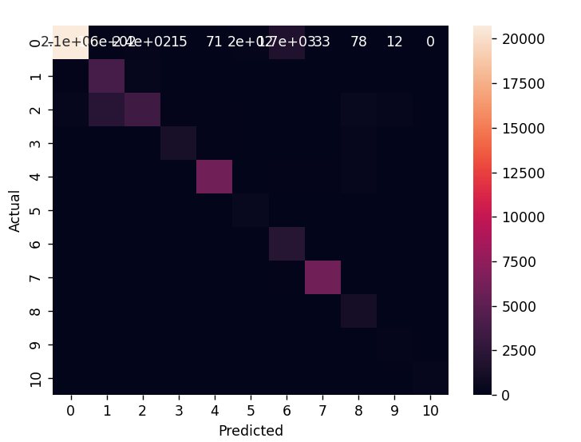
Results TB CNN

Slide 11

Difficulty & What we learn
Work with new sensors

Slide 12
Thanks for attention

